Slide 1
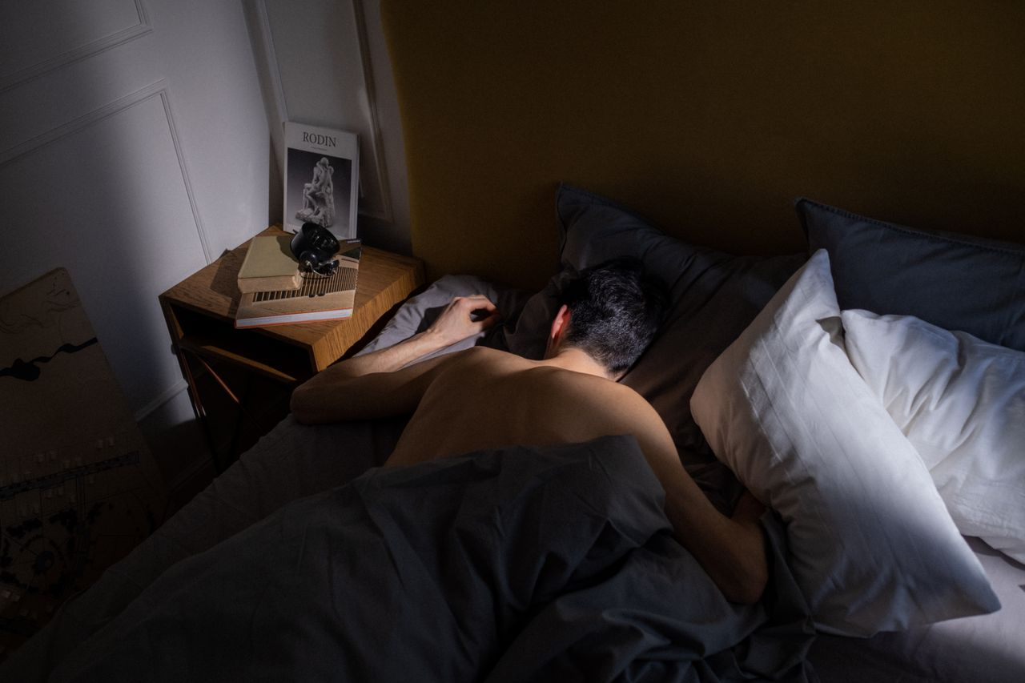
Sleep Is
Your Superpower
Grades 4–6
Together For Health

Slide 2

😴
Sleep Is Your Superpower
Kids aged 9–12 need 9–12 hours of sleep every night.
While you sleep, your brain sorts memories, your body repairs itself, and your immune system recharges.
Together For Health

Slide 3

🌙
What Happens When You Sleep?
Your brain saves everything you learned that day into memory
Your body grows and repairs muscles and tissues
Your immune system fights off sickness
Your brain clears out waste products — literally washes itself!
Your mood resets — this is why everything feels worse when you are tired
Together For Health

Slide 4
😩
What Not Enough Sleep Does
Hard to focus and learn new things
Grumpy, emotional, and easily upset
More likely to get sick
Slower reaction times — dangerous for sports and roads
Cravings for junk food increase significantly
Together For Health

Slide 5
🌟
How to Sleep Better Tonight
Set a bedtime and stick to it — even on weekends
1
No screens 1 hour before bed (blue light wakes your brain up)
2
Keep your room cool, dark, and quiet
3
Avoid caffeine after 2pm (soda, chocolate, energy drinks)
4
Do something calm before bed: reading, stretching, breathing
5
Together For Health

Slide 6
KEY TAKEAWAYS
Sleep is not lazy — it is when your body and brain repair
✓
Consistent sleep times are as important as duration
✓
Tonight: try going to bed 30 minutes earlier
✓
Resources
Sleep Foundation: sleepfoundation.org
Talk to a parent about setting a sleep schedule
Kids Health: kidshealth.org/sleep
Together For Health

